Slide 1




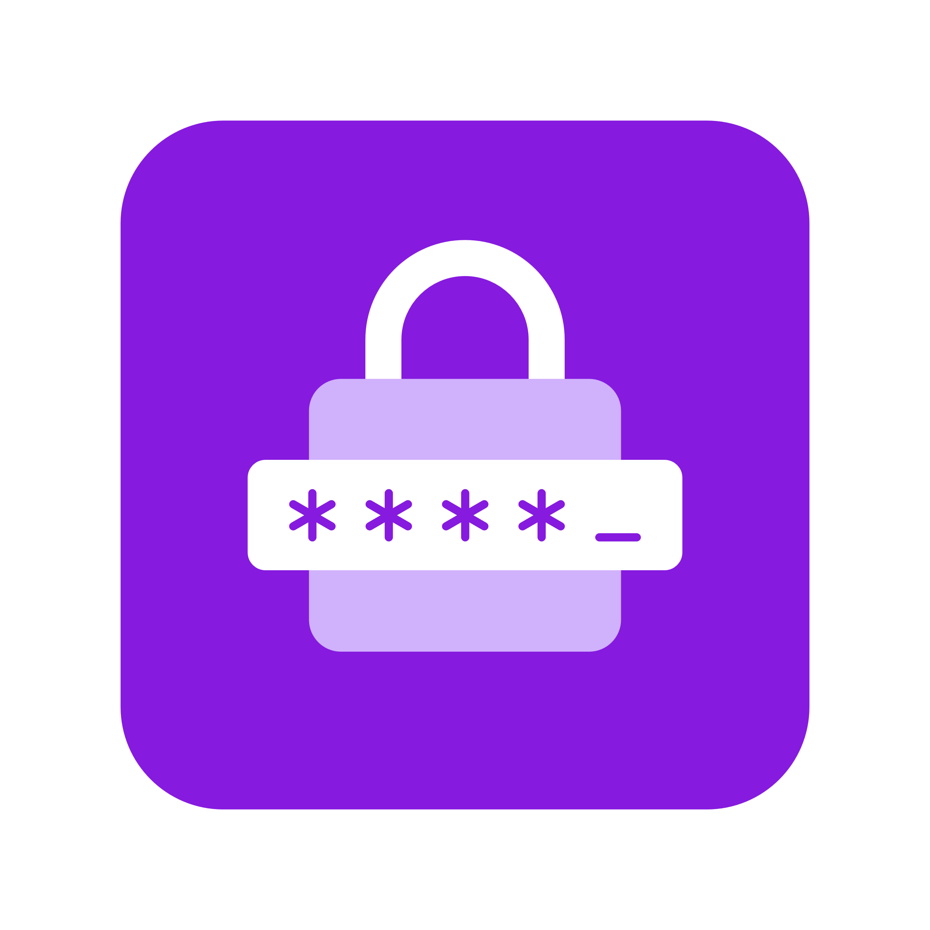



Branding Guidelines
The following icons & assets can be used for your own diagrams. Please don’t edit the designs/colors of the icons. For any questions reach out at aka.ms/radius/discord
Environment
Application
Container
Portable
Resource
Secret Store
Recipe
Gateway
Grouping
Connection
Logos & Logomark

Slide 2
Building and operating cloud-native applications with Radius
Will Velida | Lead Software Engineer, Mantel Group
@willvelida

Slide 3
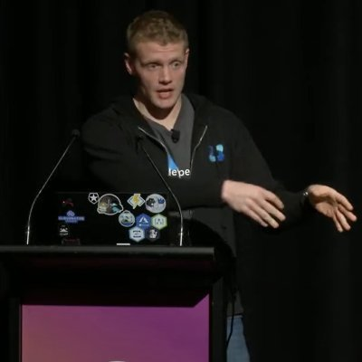
Whoami?
Lead Software Engineer at Mantel Group.
Former MSFTer and Microsoft MVP based in Auckland – Moved to Melbourne last year.
.NET and Azure developer with experience in banking, agriculture, and health industries.
Former average rugby player.

Slide 4



Why is building and running microservice apps hard?
Complex architectures
Cross-platform portability
Enforcing
best-practices
Troubleshooting
experiences

Slide 5



Standardized “app” layer across platforms
On-premises
Complex architectures
Cross-platform portability
Enforcing
best-practices
Troubleshooting
experiences

Slide 6




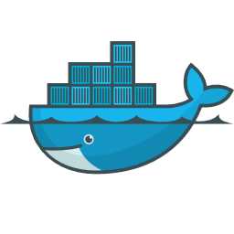




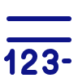





















Cloud native apps are more than just
...
Base image
Code
Ports
Entrypoint
Dockerfile
...
PowerShell
Registries
Charts
Releases
Parameters
...
Pods
Secrets
Volumes
Services
Bash
On-premises
AKS
EKS
Machines
Bicep
Blob storage
S3
Disk
GitHub Actions
Event Hubs
SQS
Kafka
CosmosDB
DynamoDB
MongoDB
...
...
...
Terraform

Slide 7


#!/bin/bash
echo "Begin $app_name installation using Helm"
infras=(sql-data nosql-data rabbitmq keystore-data basket-data)
charts=(eshop-common basket-api catalog-api identity-api mobileshoppingagg ordering-api ordering-backgroundtasks ordering-signalrhub payment-api webmvc webshoppingagg webspa webstatus webhooks-api webhooks-web)
gateways=(apigwms apigwws)
if [[ !$skip_infrastructure ]]; then
for infra in "${infras[@]}"
do
echo "Installing infrastructure: $infra"
helm install "$app_name-$infra" --namespace $namespace --set "ingress.hosts={$dns}" --values app.yaml --values inf.yaml --values $ingress_values_file --values $ingressMeshAnnotationsFile --set app.name=$app_name --set inf.k8s.dns=$dns $infra --set inf.mesh.enabled=$use_mesh
done
fi
for chart in "${charts[@]}"
do
echo "Installing: $chart"
helm install "$app_name-$chart" --namespace $namespace --set "ingress.hosts={$dns}" --values app.yaml --values inf.yaml --values $ingress_values_file --values $ingressMeshAnnotationsFile --set app.name=$app_name --set inf.k8s.dns=$dns --set image.tag=$image_tag --set image.pullPolicy=$imagePullPolicy $chart --set inf.mesh.enabled=$use_mesh
done
{
"$schema": "https://schema.management.azure.com/schemas/2015-01-01/deploymentTemplate.json#",
"contentVersion": "1.0.0.0",
"parameters": {
"namespaceprefix": {
"type": "string",
"metadata": {
"description": "Name of the Redis namespace"
}
}
},
"variables": {
"location": "[resourceGroup().location]",
"namespaceprefix": "[concat(parameters('namespaceprefix'), uniqueString(resourceGroup().id))]",
"sbVersion": "2016-04-01"
},
"resources": [
{
"type": "Microsoft.Cache/Redis",
"name": "[variables('namespaceprefix')]",
"apiVersion": "[variables('sbVersion')]",
"location": "[variables('location')]",
"scale": null,
"properties": {
"redisVersion": "3.2.7",
"sku": {
"name": "Standard",
"family": "C",
"capacity": 1
},
"enableNonSslPort": true,
#!/bin/bash
CreateGroup()
{
echo Creating resource group $resource_group in '$location'
az group create --name $resource_group --location $location
}
deployresources()
{
echo Deploying ARM template '$path_and_filename.json' in resource group $resource_group
az group deployment create --resource-group $resource_group --parameters @$path_and_filename.parameters.json --template-file $path_and_filename.json
} path_and_filename=$1
resource_group=$2
if [ "$3" == "-c" ]; then
echo "Resource Group needs to be created"
if [ "$4" == "" ]; then
echo "but Resource Group name is missing"
exit 1
else
location=$4
CreateGroup
fi
fi
deployresources
echo “All resources finished successfully"
inf:
mesh:
enabled: false # True to enable Linkerd (set by deploy-all.ps1)
tls:
enabled: false # True to enable TLS (set by deploy-all.ps1)
issuer: "" # cert-manager issuer to use for retrieving certs (set by deploy-all.ps1)
sql: # inf.sql defines the sql server databases & logins
common:
host: https://**** # SQL host
user: sa # SQL user
pwd: ********** # SQL pwd
pid: Developer
catalog: # inf.sql.catalog: settings for the catalog-api sql (user, pwd, db)
db: CatalogDb # Catalog API SQL db name
ordering: # inf.sql.ordering: settings for the ordering-api sql (user, pwd, db)
db: OrderingDb # Ordering API SQL db name
identity:
db: IdentityDb # Ordering API SQL db name
webhooks:
db: WebhooksDb # Webhooks DB
mongo:
host: ********** # Uncomment to use specify custom mongo host. By default nosql-data is used
redis: # inf.redis defines the redis' connection strings
basket:
svc: basket-data # Name of k8s svc for basket redis
constr: ******** # Connection string to Redis used by Basket API
keystore:
svc: keystore-data # Name of k8s svc for keystore-data redis
constr: ********** # Connection string to Redis used as a Keystore (by Identity API)
eventbus:
svc: rabbitmq # Name of k8s svc for rabbitmq
constr: ******** # Event bus connection string
useAzure: true # true if use Azure Service Bus. False if RabbitMQ
appinsights:
key: "" # App insights to use
{{- $name := include "catalog-api.fullname" . -}}
{{- $cfgname := printf "%s-%s" "cfg" $name -}}
apiVersion: apps/v1
kind: Deployment
metadata:
name: {{ template "catalog-api.fullname" . }}
labels:
ufo: {{ $cfgname}}
app: {{ template "catalog-api.name" . }}
chart: {{ template "catalog-api.chart" . }}
release: {{ .Release.Name }}
heritage: {{ .Release.Service }}
spec:
replicas: {{ .Values.replicaCount }}
selector:
matchLabels:
app: {{ template "catalog-api.name" . }}
release: {{ .Release.Name }}
template:
metadata:
labels:
app: {{ template "catalog-api.name" . }}
release: {{ .Release.Name }}
{{ if .Values.inf.mesh.enabled -}}
annotations:
linkerd.io/inject: enabled
{{- end }}
spec:
{{ if .Values.inf.registry -}}
imagePullSecrets:
- name: {{ .Values.inf.registry.secretName }}
{{- end }}
containers:
- name: {{ .Chart.Name }}
{{ if .Values.probes -}}
{{- if .Values.probes.liveness -}}

Slide 8

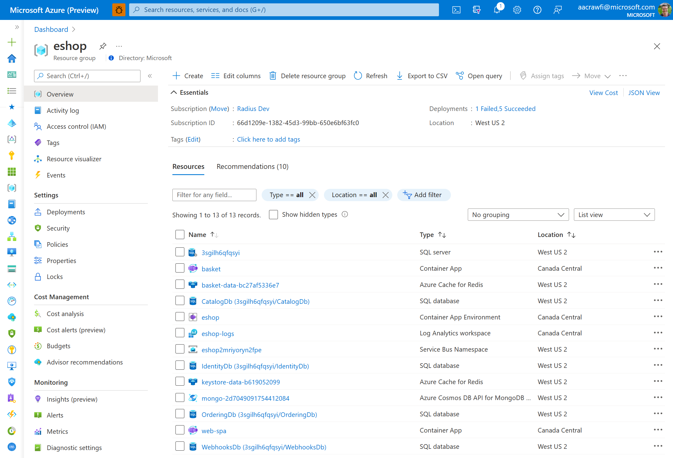
APPS TODAY Flat Lists of Resources

Slide 9
Cloud-native application platform
that works on any cloud

Slide 10
Team
Collaboration
Infrastructure Recipes
Application
Graph
Cloud
Neutral
Radius Application and Environments allow developers to work with operations on application definition + delivery
Swappable infrastructure with popular IaC tools that follows org best practices and IT policy
by default
Understand
how services and infrastructure in an application are interconnected
Deploy across development, on-premises, and cloud environments with a consistent experience

Slide 11











Cloud-native applications
containing
Team
Collaboration
Infrastructure Recipes
Application
Graph
Cloud
Neutral
Any cloud or edge infrastructure

Slide 12






Application
Internet
Gateway
Frontend
Container
Backend
Container
Redis
Cache
SQL
Database

Slide 13

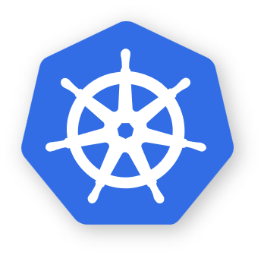





Environment
RECIPES
Redis
Container
SQL
Container
Local development
COMPUTE
CNCF-certified
Kubernetes
Application
Environment
Internet
Gateway
RECIPES
Azure Cache
for Redis
Azure
SQL DB
Frontend
Container
RECIPES
Backend
Container
Redis
Cache
COMPUTE
Azure
Kubernetes Service
SQL
Database
Environment
RECIPES
AWS
MemoryDB
AWS
DocumentDB
COMPUTE
Elastic
Kubernetes Service

Slide 14
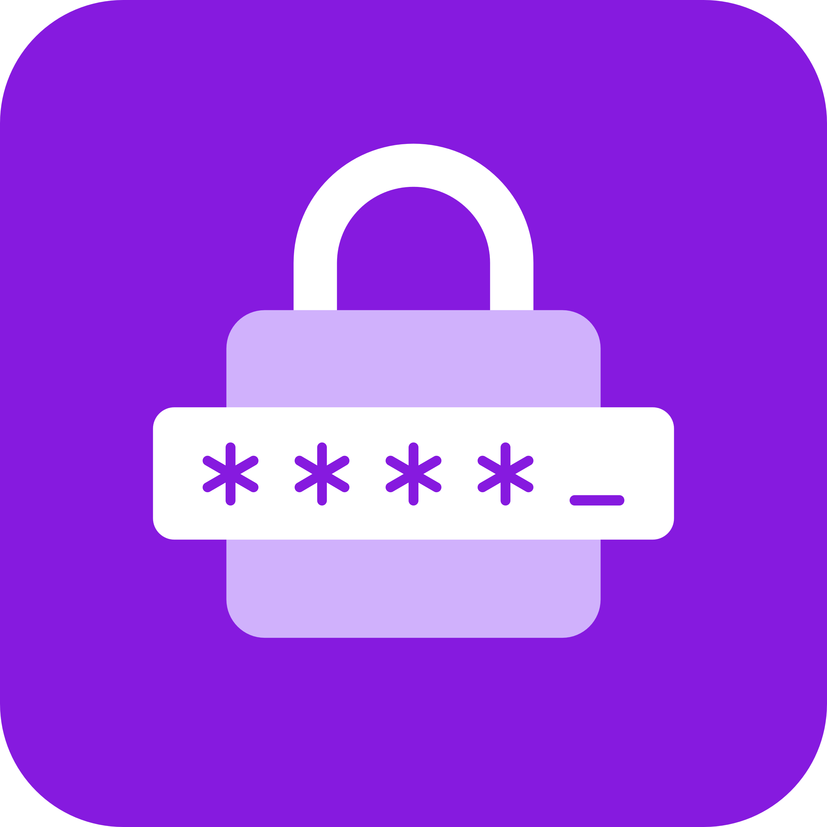




Application
Core
resources
Container
Connection
Gateway
Secret Store
Standard resources
Redis
Mongo
SQL
Dapr
RabbitMQ
Extensible
Any cloud or on-premises resource
Azure
AWS
Kubernetes
Any platform
Environment
RECIPES
On-premises

Slide 15



Recipes
Azure
SQL DB
Container
SQL DB
AWS RDS
SQL Edge
Container
Services access consistent connection strings and values
Infrastructure automatically deployed and configured
Leverage your existing IaC templates
Bicep
Extensible…

Slide 16


Platform Engineering with Radius
Developers define application requirements and business logic
Operators define infrastructure security, cost, and compliance
Applications
Environments
Recipes
On-premises

Slide 17
Let’s build some Radius Applications!

Slide 18
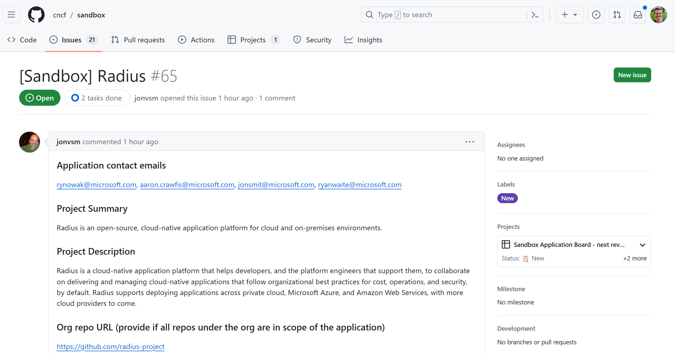
Submitted to CNCF
aka.ms/radius-cncf

Slide 19



radapp.io
aka.ms/radius/discord
github.com/radius-project

Slide 20



Thanks for listening!
willvelida.com
github.com/willvelida
twitter.com/willvelida
linkedin.com/in/willvelida
youtube.com/@willvelida

